Slide 1
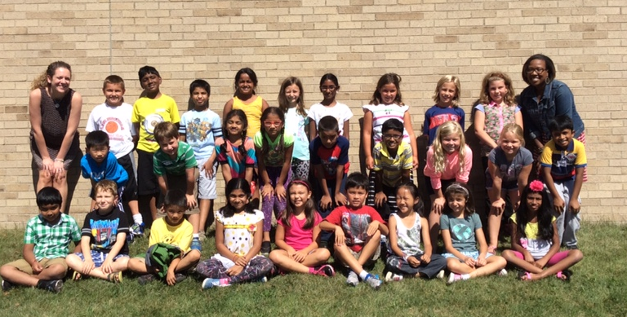
Welcome to Room 12!
Class Picture Goes in this Section
Mrs. Pawlus & Mrs. Reinhart
2015-2016

Slide 2








A little about your child’s 3rd grade teachers
Mrs. Pawlus
Mrs. Reinhart

Slide 3
Our Unique Classroom
Two teachers
  constant communication
Report cards
Small group instruction
Daily structure consistent
Joint Email
Expectations (homework, behavior, etc.)
Sharing circles
S
Notes:
shar

Slide 4



Parent Teacher Communication
Contacting Us
One of the most important parts of your student having a successful year involves communication between all of us.
We can BEST be reached by e-mail at bemisroom12@troy.k12.mi.us
School phone# (248)823-4119
Contacting You
Please check our class website for up-to-date information
We will use e-blasts for various day to day reminders
iPads will be used for assignment books
E
Notes:
erin

Slide 5
Lunch
You may put money on your child’s account online using the Point of Sale System. If you have any questions about the program, please call food service at 248-823-5089.
Lunch menus are on the Bemis webpage, so be sure to check it at the beginning of each month as copies are not sent home!
3rd grade’s lunch is from 12:10-12:50 each day.
E
Notes:
erin

Slide 6

Birthdays
We have 28 children in class this year.
Following our new district policy, students may not bring in birthday treats.
Suggestions:
  Have your child bring in a favorite book to read to the class.
  Donate a book to the class library.
  Bring in a recess game to play or donate to our recess supplies.
  Decorate a poster to celebrate the big day!
S
Notes:
shari

Slide 7
Specials Schedule
Day | Special
1A | Media
1B, 2B | Music
1C, 2C | Gym
1D, 2D | Art
2A | Spanish
E
Notes:
erin

Slide 8
Friend of the Week
Student nominated
Each child gets the award for one week.
During their week:
  Bring 4 pictures from home
  Work in the clubhouse during the day
  Parent letter
  Math leader
  Homework helper
E
Notes:
erin

Slide 9
Reader’s Workshop
Daily focused lessons
  30-45 minutes daily of reading practice (IDR time)
  One-on-one instruction
  Small group instruction
  Whole group instruction
Units include:
  Reading with Independence
  Understanding Characters
  Reading in Book Clubs:
    Mystery Series
    Nonfiction Reading with Independence.
S
Notes:
shari

Slide 10

Reader’s Workshop
How might you support your child with Reading at home?
Read at home with your student
Casually discuss the events in the book together
Encourage your student to use their device to share their book with others
S
Notes:
shari

Slide 11
Writer's Workshop
Daily Writing Practice
  Mixture of whole group, small group and individual instruction will be given to each student.
  Brainstorming, prewriting, editing, revising, publishing will be practiced throughout each unit.
  Units include:
    Personal Narrative
    Realistic Fiction
    Personal Essay
    Research Report
    Informational Writing
E
Notes:
erin

Slide 12
Writer's Workshop
How might you support your child with writing at home?
At home journaling
Individual creativity in storytelling
Digital storytelling
Graphic novel storytelling (comic strip writing)
E
Notes:
erin

Slide 13
Math Workshop
Everyday we will spend one hour doing math workshop.
  Small and large group instruction
  Groups determined by pretest and observations.
  Fluency Practice
  Math Writing
Third Grade Math Skills:
  Multiplication and Division (0-5, 9, 10)
  Multiplication and Division 6-8, Multiplication with multiples of 10
  Measurement, Time, and Graphs
  Multi-digit Addition and Subtraction
  Write Equations to Solve Word Problems
  Polygons, Perimeter, and Area
  Explore Fractions
S
Notes:
shari

Slide 14
Math Workshop
How might you support your child with math at home?
  Ask your child to pick a problem and tell you how they solved it step by step
  Create a how to video clip for a struggling student
  Ask students to teach you the “new” math they are learning
S
Notes:
shari

Slide 15
Word Study
Each day we will spend 20-30 minutes on word study (spelling).
  Words Their Way Program
  Pretests
  Groups
  Patterns and high frequency words
  Weekly Tests/homework
How might I support my child with word study at home?
  Journal writing
  Look for patterns learned in everyday print—make a contest out of it
E
Notes:
erin

Slide 16
Science
Science instruction will incorporate a combination of informational reading as well as hands-on learning. Students will be asked to make observations, draw conclusions, and apply their new learning to real world problems.
Topics of Study:
Measurement
Water
Light and Heat
Sun, Moon, and Stars
Life Structures
S
Notes:
shari

Slide 17
Social Studies
Students will “tour” the United States to learn about the regions and various attractions while studying how geography, climate and natural resources have affected the history and development of our US regions.
Geography Challenge
Mapping
Culture, economics, geography, government topics
Group and independent work
E
Notes:
erin

Slide 18

Visible Thinking
A broad and flexible framework in which classroom lessons are structured to achieve the following:
  Deeper understanding of content
  Greater motivation for learning
  Development of learners' thinking and learning abilities.
  Development of learners' attitudes toward thinking and learning, and their alertness to opportunities for thinking and learning.
  A shift in classroom culture toward a community of thinkers and learners.
  Students explore and investigate topics and concepts through "thinking routines".
  Students will obtain life skills necessary to help them prepare for life in the 21st century.
E
Notes:
erin

Slide 19
Homework
Each third grader will be expected to complete nightly homework.
Assignment books
Completed on time
Quality expectations
Daily work completion, additional tasks, studying for tests.
S
Notes:
shari

Slide 20
Homework
When students forget to do an assignment, they will need to complete it during recess.
We would like students to become accountable for their homework.
Here is how you can help…
Encourage your child to email us questions and come to us with homework concerns.
S
Notes:
shari

Slide 21
Book-It Projects
Each month the students will be asked to complete a Book-It reading project.
Different genres/thinking routines
Nightly reading
Student led projects
Class presentations
Rewards
Student Led—Talk to us
E
Notes:
erin

Slide 22

One-2-World
  critical thinking and problem solving
  engagement
  connection to global society
  student centered classrooms
  deep understanding
  preparation to become global citizens
  career and college readiness
  adaptability to our changing world
  The Three C’s
    Create
    Communicate
    Collaborate
Why Technology
S
Notes:
shari

Slide 23







3rd grade iPads
iPads will be used to CREATE, COMMUNICATE and COLLABORATE
  Create
  Communicate
  Collaborate
S
Notes:
shari

Slide 24


How might I support the 3C’s at home?
iPads can and should be used for more than just games at home.
Please see the iPads at Home handout for ideas!
S
Notes:
shari

Slide 25




Regularly used apps
Seesaw Front Row Class Dojo Tellagami
Blogging Educreations iMovie Keynote
S
Notes:
shari

Slide 26

Digital citizenship
Your child’s device can offer you insight that you SHOULD be using to help you know if your child is being a good digital citizen
EASY ways to assess and manage your child’s online behavior
S
Notes:
shari

Slide 27

1. Clear Expectations
iPads are for educational use only
iPads do not belong in bedrooms - they are charged in a common area
iPads do not belong to the child- they belong to the school and, when at home, the parents
*setting these expectations will help alleviate future issues*
S
Notes:
shari

Slide 28

2. Open communication
Questions you should ask your child:
  What are you working on/doing?
  Show me your email, please. (sent items/deleted)
  Have you created any new passwords recently?
  Show me what you’ve been looking at online. (history)
  Show me your photos/videos/photo stream. (deleted)
  Have you run into anything online that you thought was inappropriate? What did you do?
  Show me what apps you’ve downloaded recently. How are they related to what you’re working on in school?
S
Notes:
shari

Slide 29
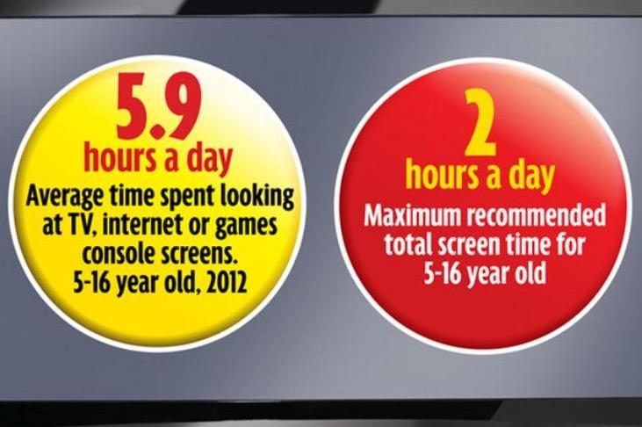
3. Set time limits
For the most part, children should ONLY be using the iPad for tasks their teacher has given them for homework. If your child isn’t watching TV for the evening, then perhaps there is an opportunity for a game app.
S
Notes:
shari

Slide 30
Volunteers
We love classroom helpers!
Tuesday and Thursday
There are many ways in which you can support your child’s classroom!
  Clerical (copies, laminating, etc.)
  Reader’s workshop
  Math workstation helper
  Field Trips
If you are interested in being a classroom volunteer, sign up at the back table after the presentation! ☺
E
Notes:
erin

Slide 31
miscellaneous
Snack – We will have a snack each morning usually around 10:15 a.m. Please send one healthy snack each day. Water bottles are fine to bring.
Book Orders – I will send home periodic book orders and place orders about once a month.
Class website – Will be updated weekly. Please be sure to check here for important information.
Mark Your Calendars:
  M-STEP-Begins Spring 2016
  School Time: 8:34-3:32. Tardy bell is 8:40am.
  ½ day dismissal 12:15pm
E
Notes:
erin

Slide 32
Thank You...
for taking the time to attend Curriculum Night!
We look forward to working with you and your child this year. It is going to be a wonderful year filled with exciting learning activities!
E
Notes:
erin

Slide 33
Before you Leave Tonight…
Add you email address to the website using your student’s iPad.
Visit the donation station
Use the QR code to join Seesaw
Letter to your child
S
Notes:
shari

